Slide 1
CAMM Bi-Weekly Highlights
June 06, 2013

Slide 2
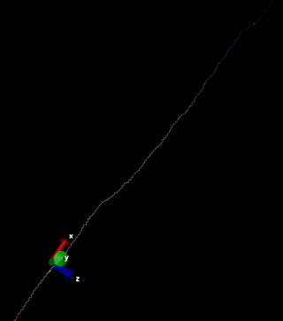
Project updates: CAMM
New project: Complementary CNCS experiment / MD simulation studies of the Boson peak in Poly-L-Glutamic acid (polyE) homopolymers
The Boson peak is a collective excitation in the 2-5 meV range, universally observed in soft-matter materials.
polyE displays a Boson peak that shifts in energy upon changes in the environment.
Quais-elastic data collected at CNCS beamline.
Current Status: Preparation of simulation system
(animated gif) One of the preparation steps in the simulation involves the collapse of the homopolymer chain from an initial stretched conformation

